Slide 1
Data Aggregation Tool (VBA)
UC Davis: Biochemical Engineer
GA Tech: Analytics

Slide 2





About - Me
Education
Biochemical Engineering (2015)
Masters in Analytics (2020)
Work Experience
Virology Research (1.5 years)
Process Engineer II (1.0 years)
Process Scientist I (2.75 years)
Consultant (2 mo)

Slide 3
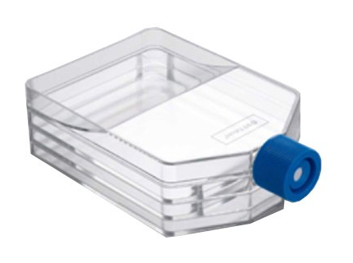
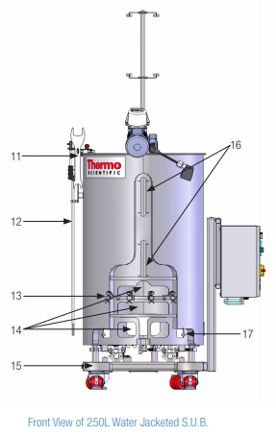
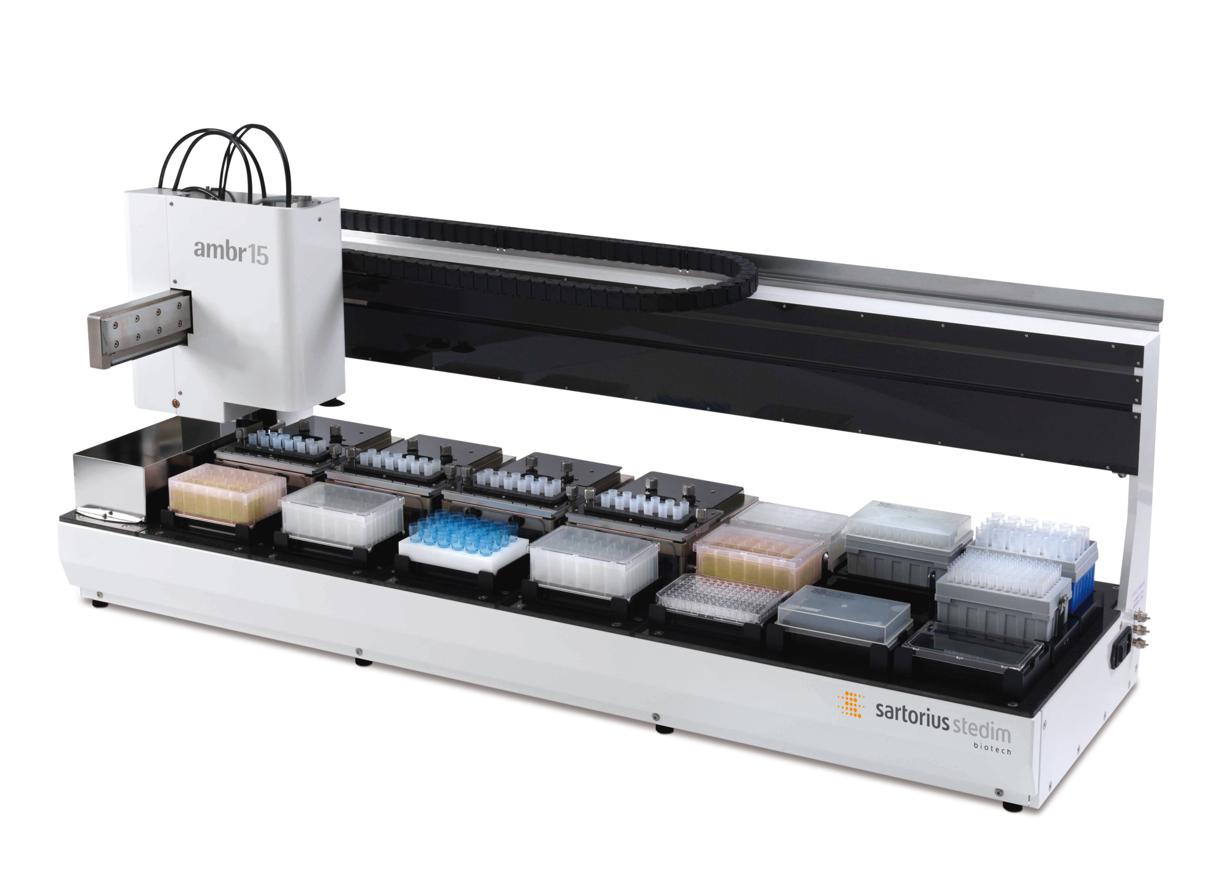








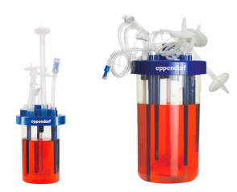
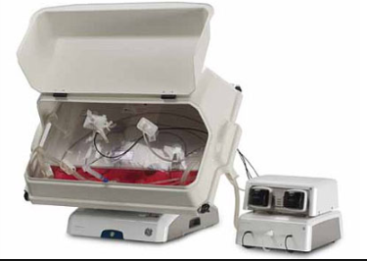



About – Software/Hardware & Programming Experience
Equipment (5-layer flasks, Ambr15, Waves, Stainless Steel reactors, disposable reactors)
Software
Programming

Slide 4
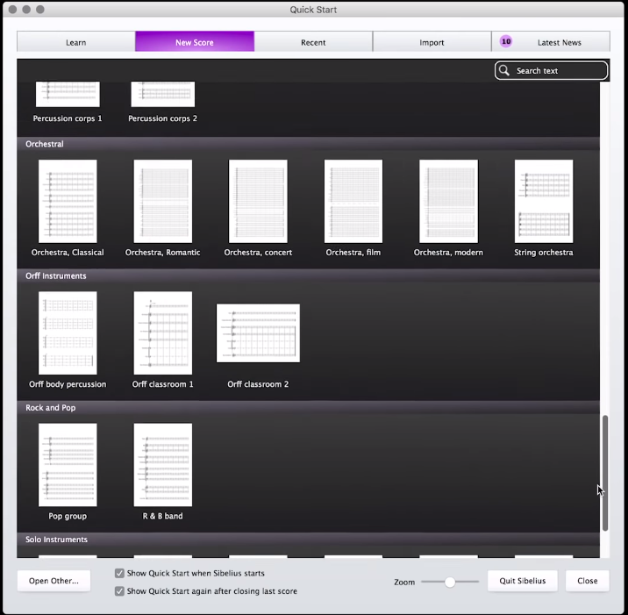
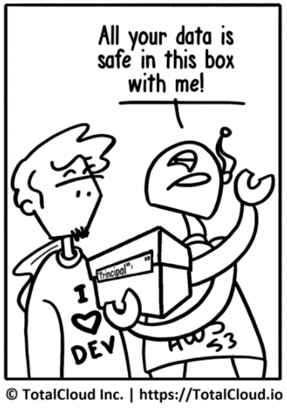

Initial Problem
Example of how NOT to design your UI (A music software)
“What is ‘Pi’?”
A Data Historian system by OSISoft which can track multiple tags from bioreactors simultaneously
Problem?
People knew of Pi, but many could not access the info efficiently
Many found it tedious to access the information they desired
Solution?
Design an efficient program
Quit?! Where is confirm??

Slide 5
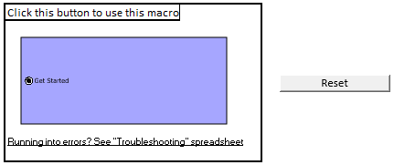
Data Querying Program Goals
Project goals:
Obtain Pi Data efficiently
Eliminate operator need-to-know of OSIsoft PI Data Historian or underlying VBA
Requirements:
Macro should be easy to utilize
Data output should be easily ported over to Spotfire for visual analysis
Code must be written such that facility fit upgrades (such as addition of a new reactors or new Pi tags) can be updated without programming knowledge
Solution:
I chose to program in VBA
“Build your program in a language that is optimal to the end user”
Everyone knows how to use Excel
Userforms can be designed to lead customer interaction through the software
Everyone knows how to click buttons!

Slide 6
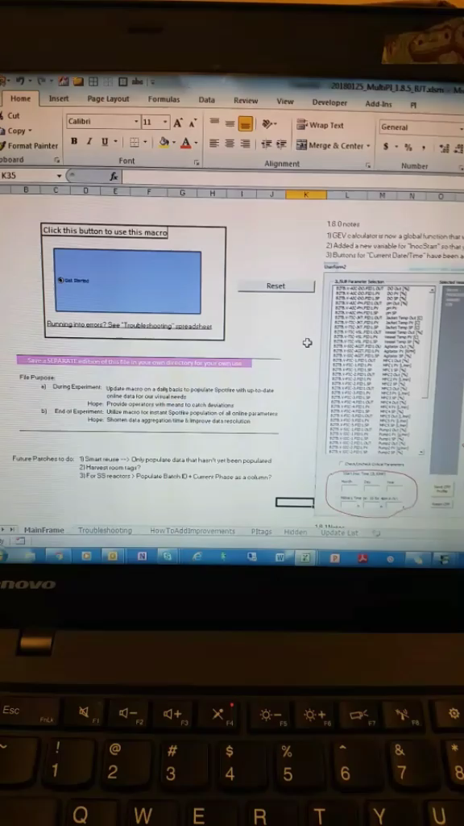
The result - MultiPi
A program that was easy to use
So easy in fact…
people still don’t know what Pi is at BI
Program Usage (In a nutshell):
1) Select bioreactors
2) Define bioreactors
3) Select Pi Tags
4) Specify START / END
5) Specify STEP interval
6) Accept Parameters before computation starts
7) Save the file output
8) Open the file in Spotfire Template
Detailed program usage on following slides
Video

Slide 7
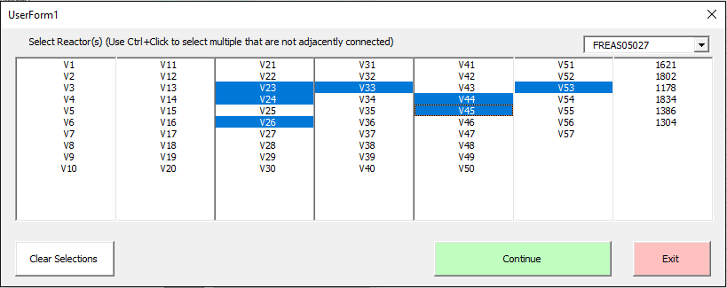
MultiPi Interface (1/3)
Select Server
Select Bioreactor(s)
Color scheme:
Green = Forward
Red = Quit
Blue = Go back 1 step (Not shown for 1st step!)

Slide 8
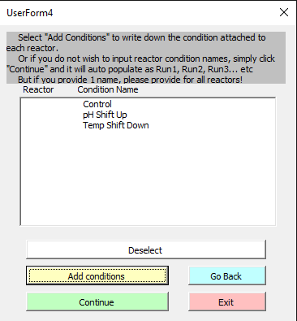
MultiPi Interface (2/3)
Define your bioreactor(s) as you wish
Ex: Control
Ex2: pH Shift Up
Ex3: Temp Shift Down
V10
V12
V52

Slide 9
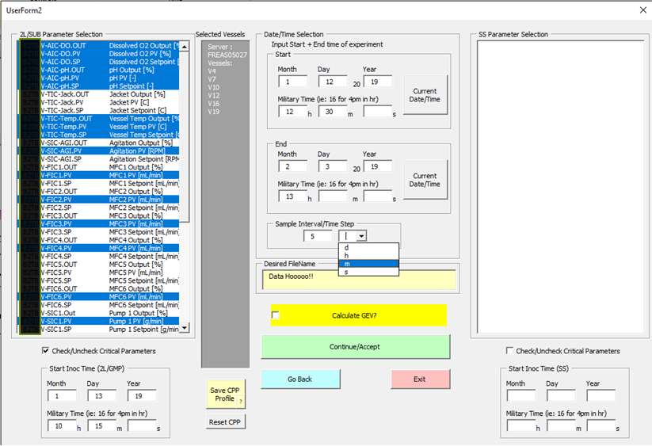
MultiPi Interface (3/3)
Select Pi Tag(s)
Input Start
Input End
Input Step-size
(Everything else is optional!)
Note:
Grey box details bioreactors
Bottom-left for “Runtime”

Slide 10
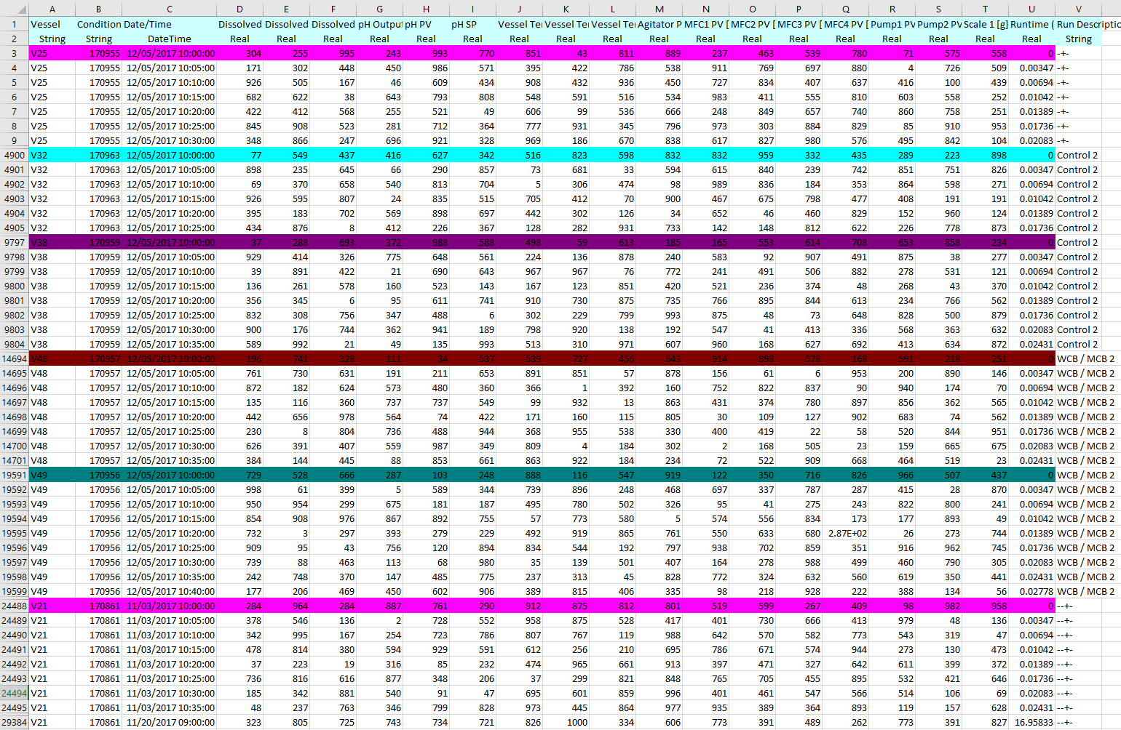
MultiPi Output
Reactor by Reactor output
Colors utilized to assist in human parsing of bioreactor to bioreactor data
Digestible by Spotfire (data tags available on row 2) or JMP (Simply delete the data tag row on row 2)
*Data shown are randomized numbers
29384 rows * 17 tags = 499,528 data points took ~6min

Slide 11
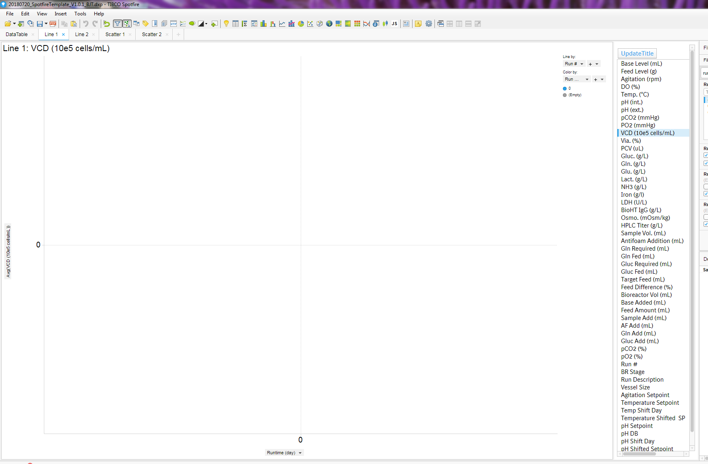
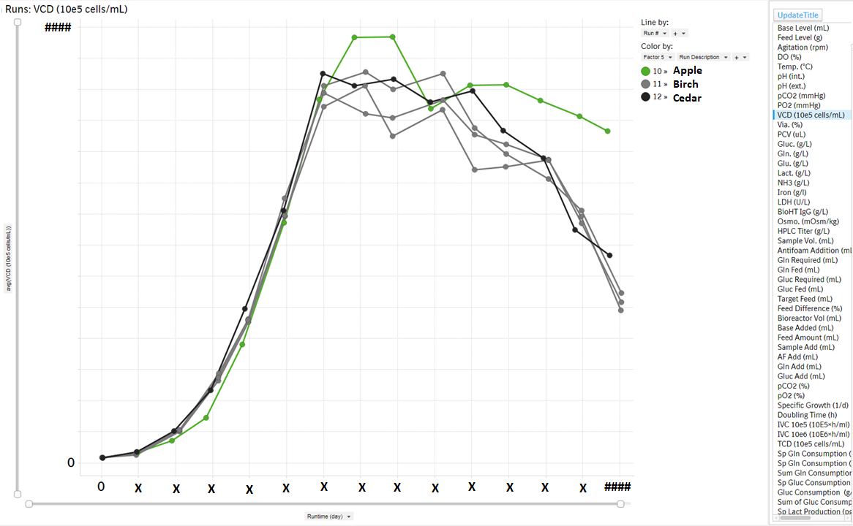
Spotfire Integration
Template created in Spotfire
Reads all column names in uploaded file into Listbox registry
Automatically plots selected entry from ListBox
Example shown is for “Runfile” project plotting VCD

Slide 12
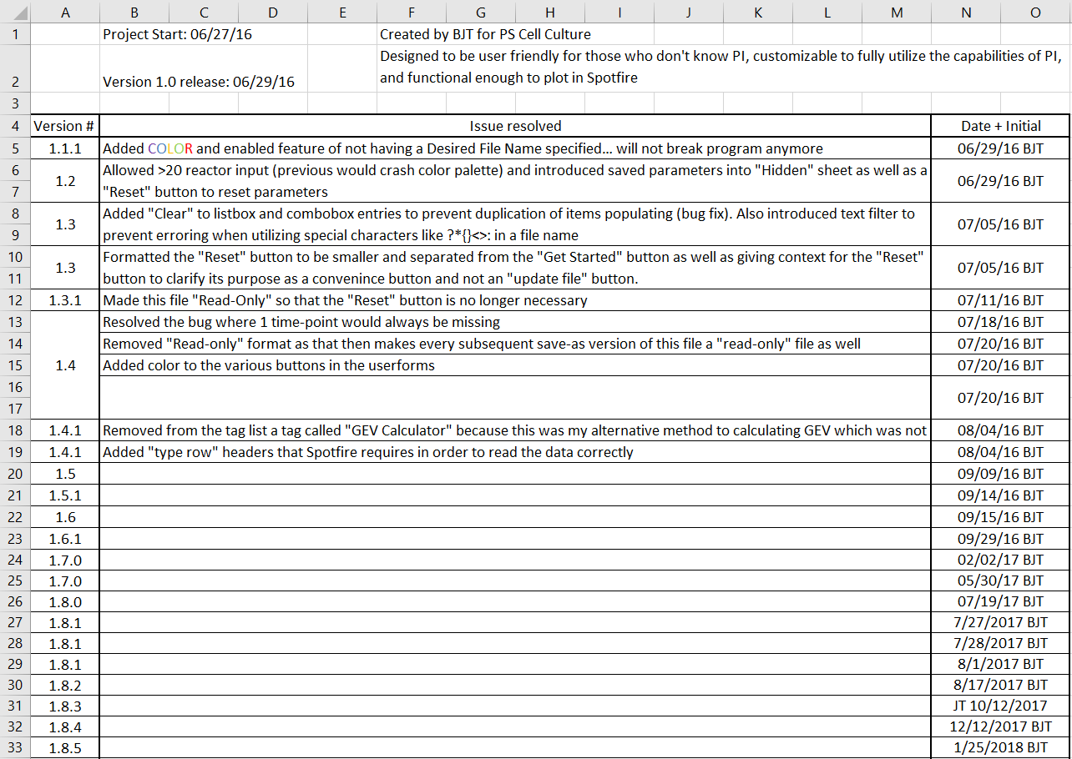
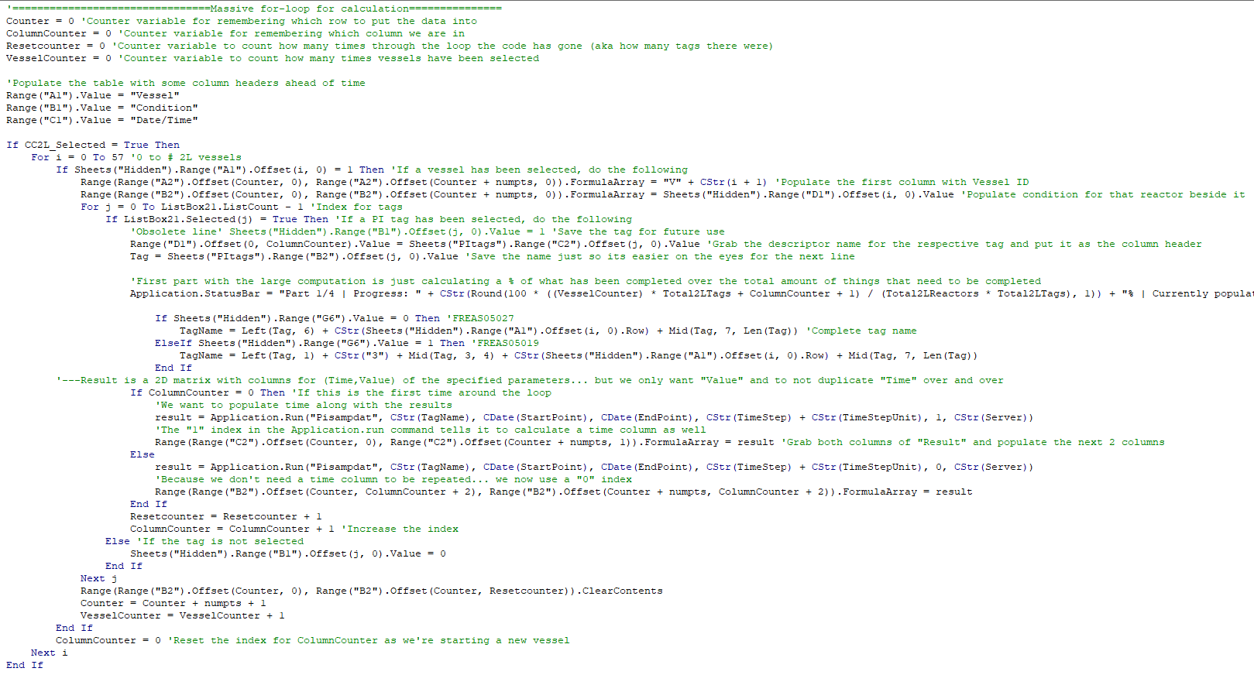
MultiPi Version Control
Updates would be made to:
Add new features
Improve upon old features
Fix bugs
All changes were documented
Code is highly commented

Slide 13



MultiPi Goal Check
Project goals:
Obtain Pi Data efficiently
Eliminate operator need-to-know of OSIsoft PI Data Historian or underlying VBA
Macro should be easy to utilize
Data output should be easily ported over to Spotfire for visual analysis
Code must be written such that facility fit upgrades (such as addition of a new reactors or new Pi tags) can be updated without programming knowledge

Slide 14
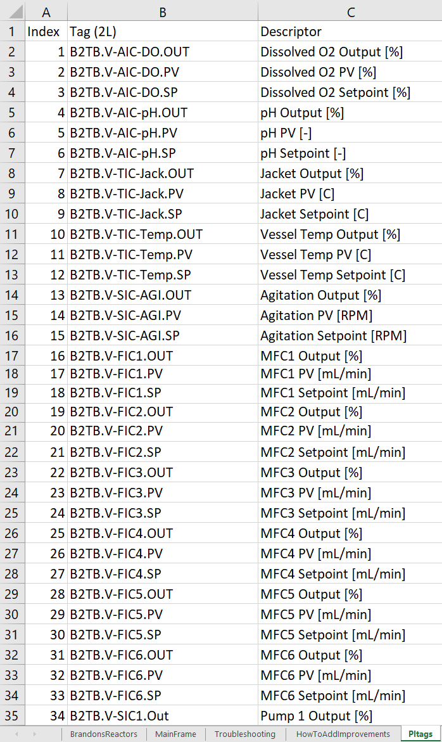
MultiPi Goal Check
“can be updated without programming knowledge”
If PI servers updated to a new address, tags got renamed, or new tags were added
All of the coding referenced excel sheets for non-coder modification
If expansion happens and more than 57 reactors exist?
… Honestly I forgot to put this outside of the code.
I’m still waiting for the day they call me about this

Slide 15

MultiPi in Summary
Program became tool to query data most people never knew how to access in the first place
Both non-GMP and GMP registries were built-in
People in other departments are utilizing my program
Process Tech Transfer Specialist getting data to a client
Clinical Ops comparing batch to batch performance
MultiPi grabs 20 reactors for 12 tags across 14 days in ~15minutes
>500% efficiency increase to how most people were grabbing the data into excel
Great care was taken for the customer:
Each GUI was drawn out and drafted before finalizing in VBA
Many features were built-in for end-user comfort (Ex: Pre-selection of Pi-tags in a single checkbox click)
Updates could be done on the excelbook 🡪 No VBA required!

